Slide 1
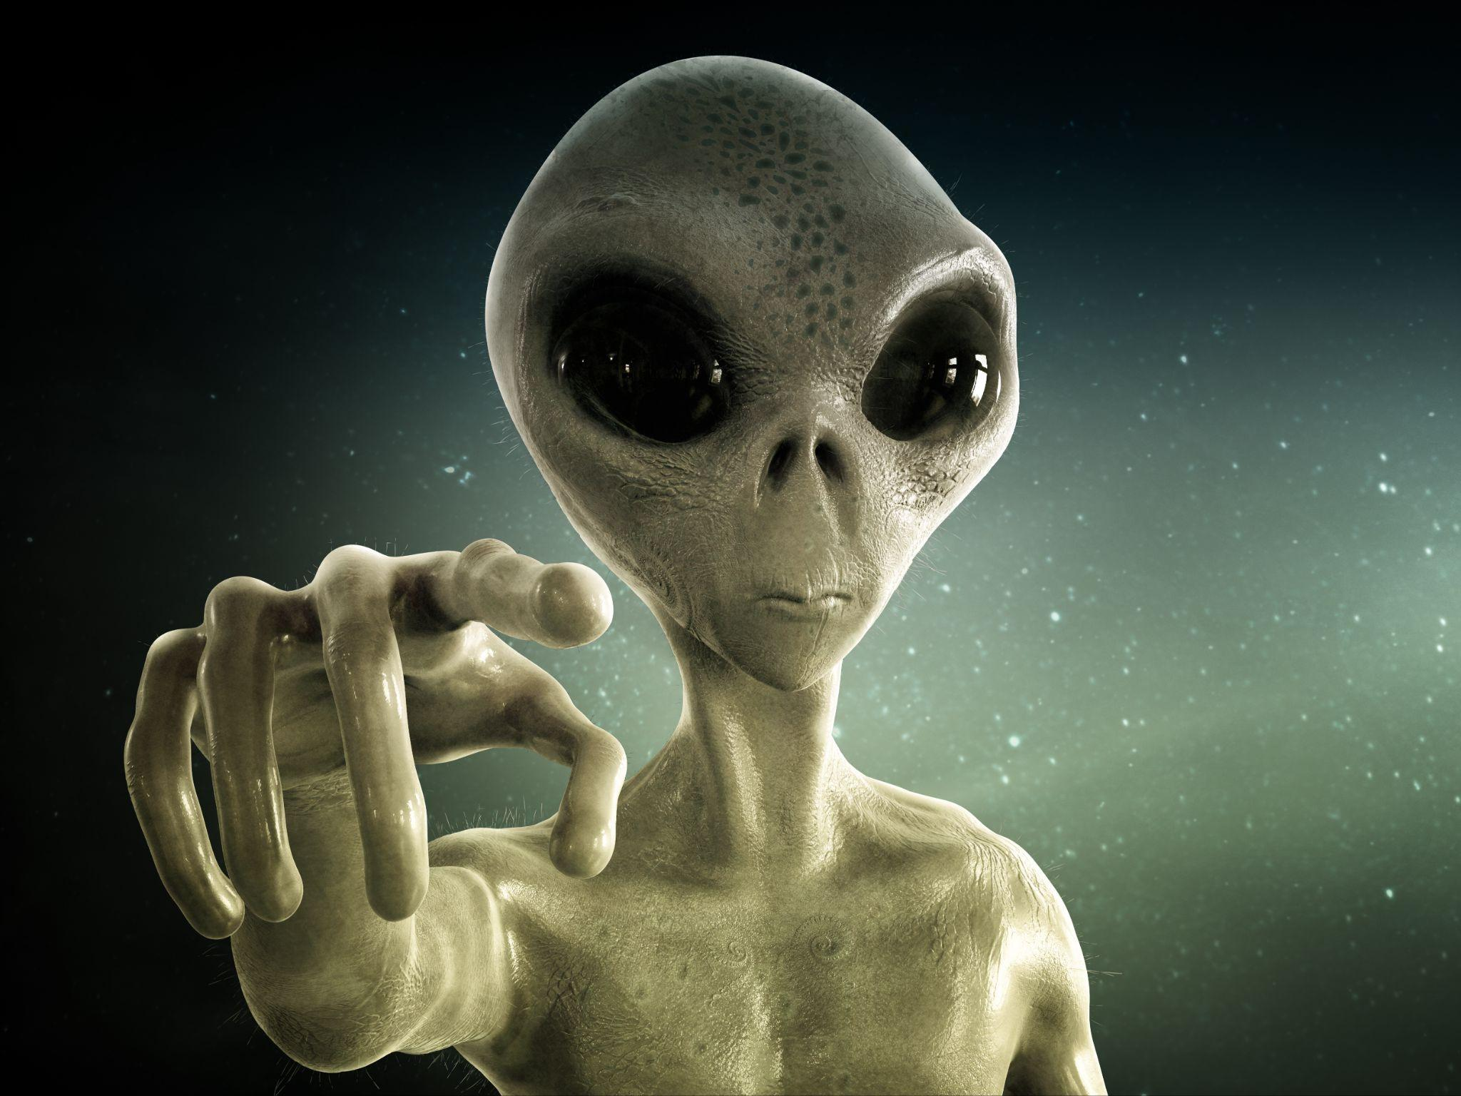
Close Encounters of the Third Kind

Slide 2
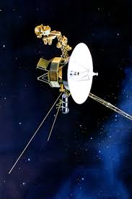
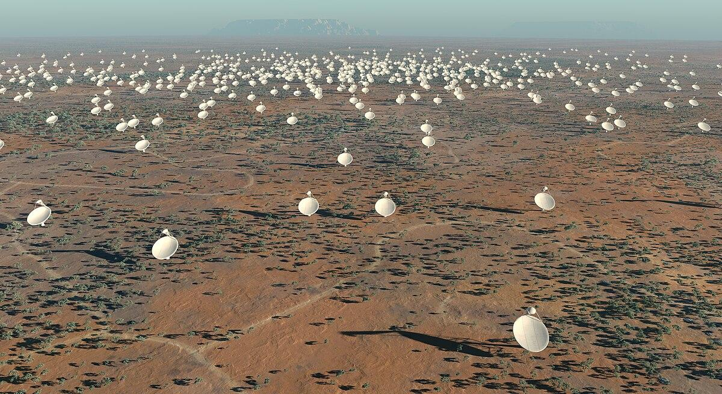
How We Broadcast Ourselves
Radio Waves
Voyager
Habitable atmosphere
Lasers
Direct transmissions
Notes:
200 ish light years. First real transmission is 1936 Berlin Olympic Games.
We are out pashing radio
January 16, 1995 15 billion miles away. Reached interstellar in 2012

Slide 3
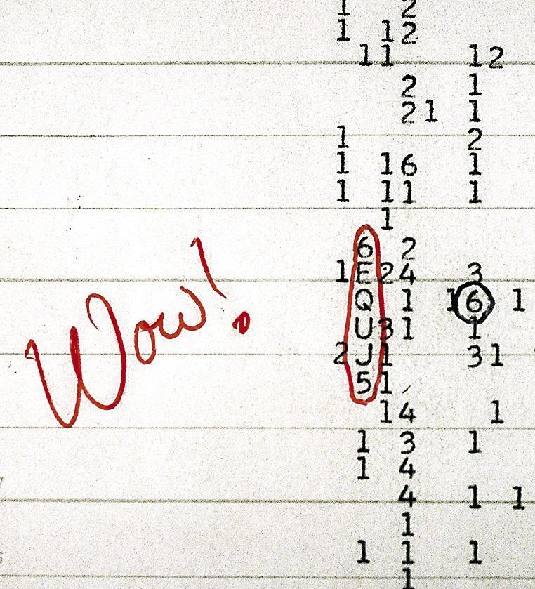
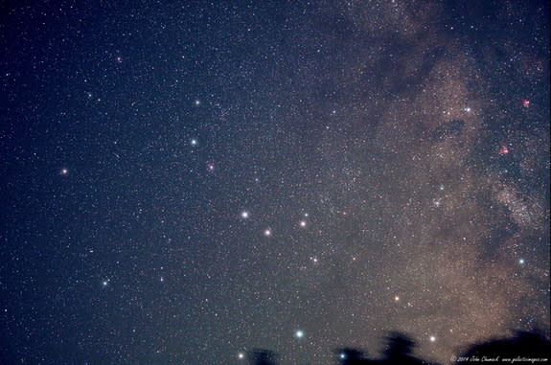
WOW Signal
1977
Burst of energy over planet
Cannot be recreated
Still unsure what caused it
Sent a message back in 2012
Notes:
Sagittarius

Slide 4
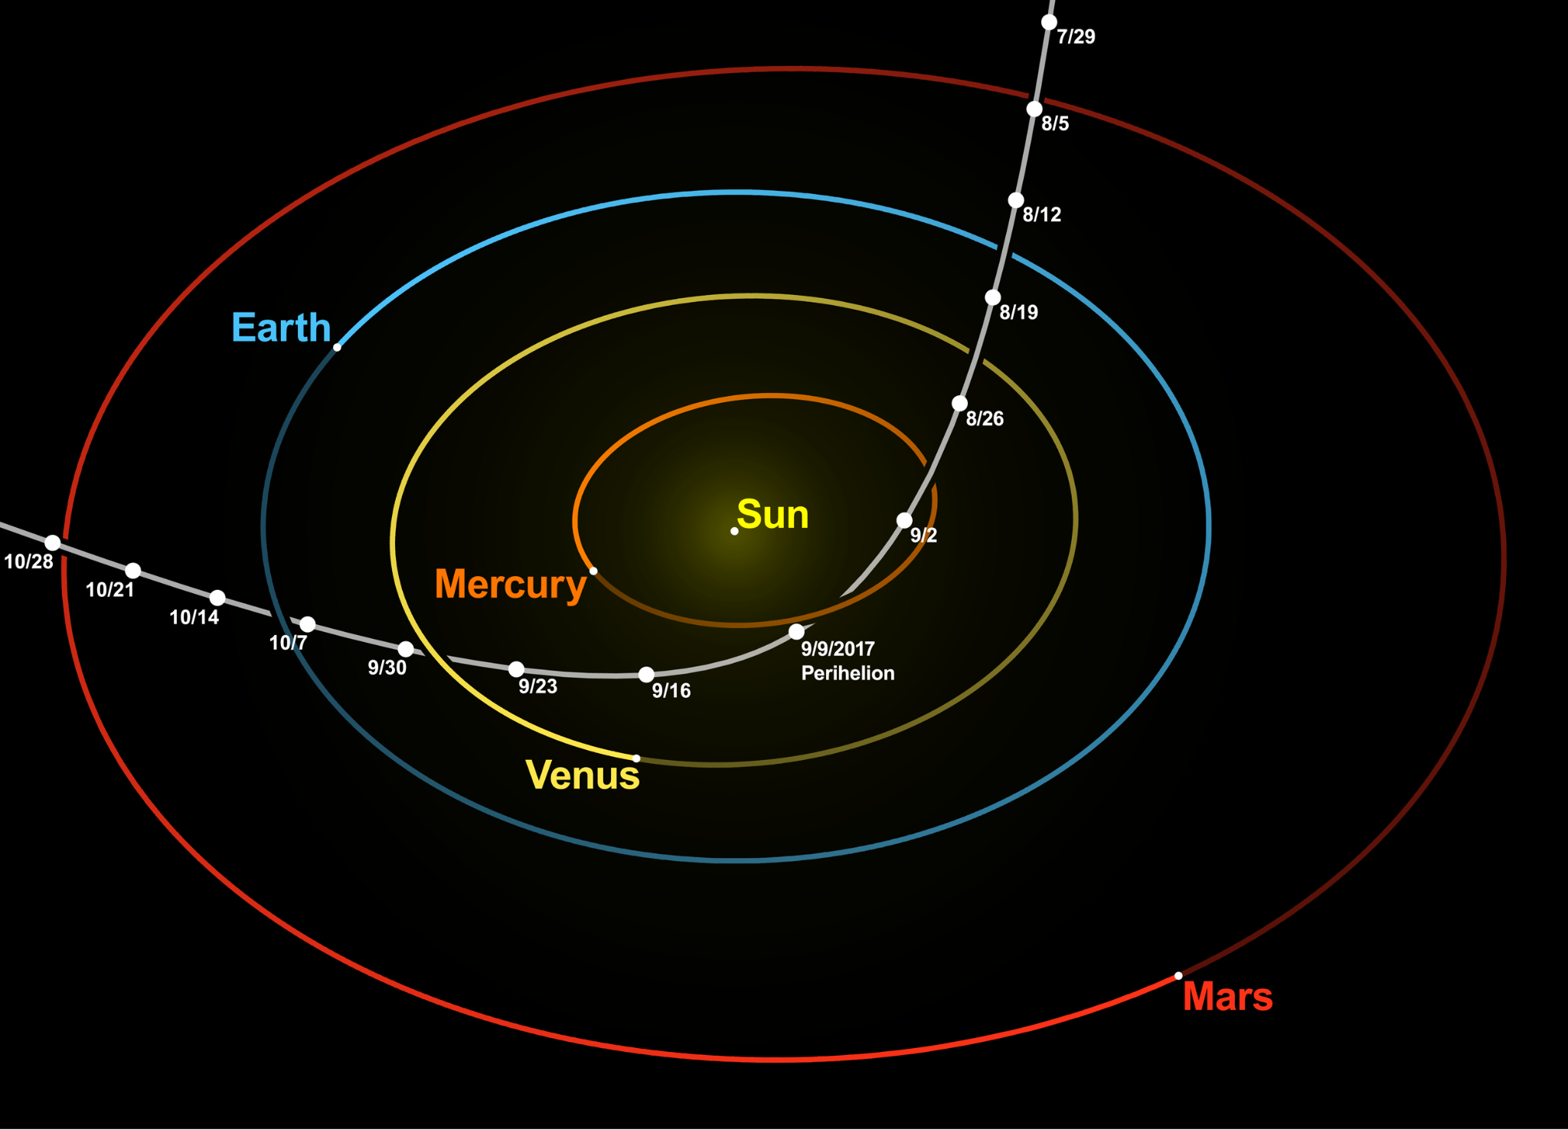
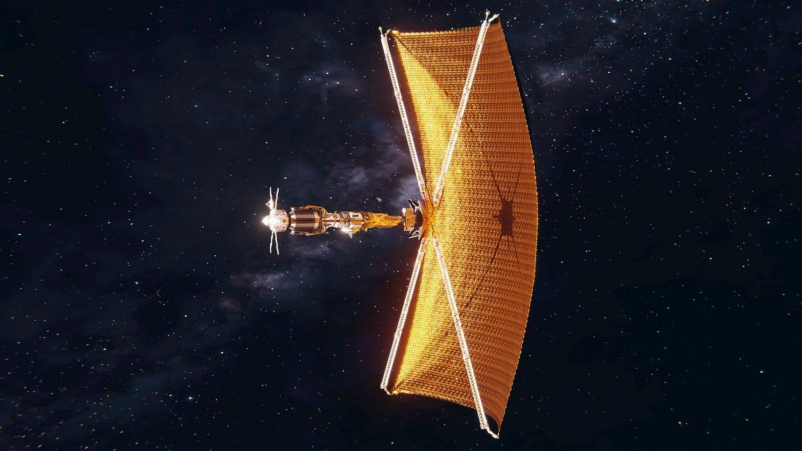
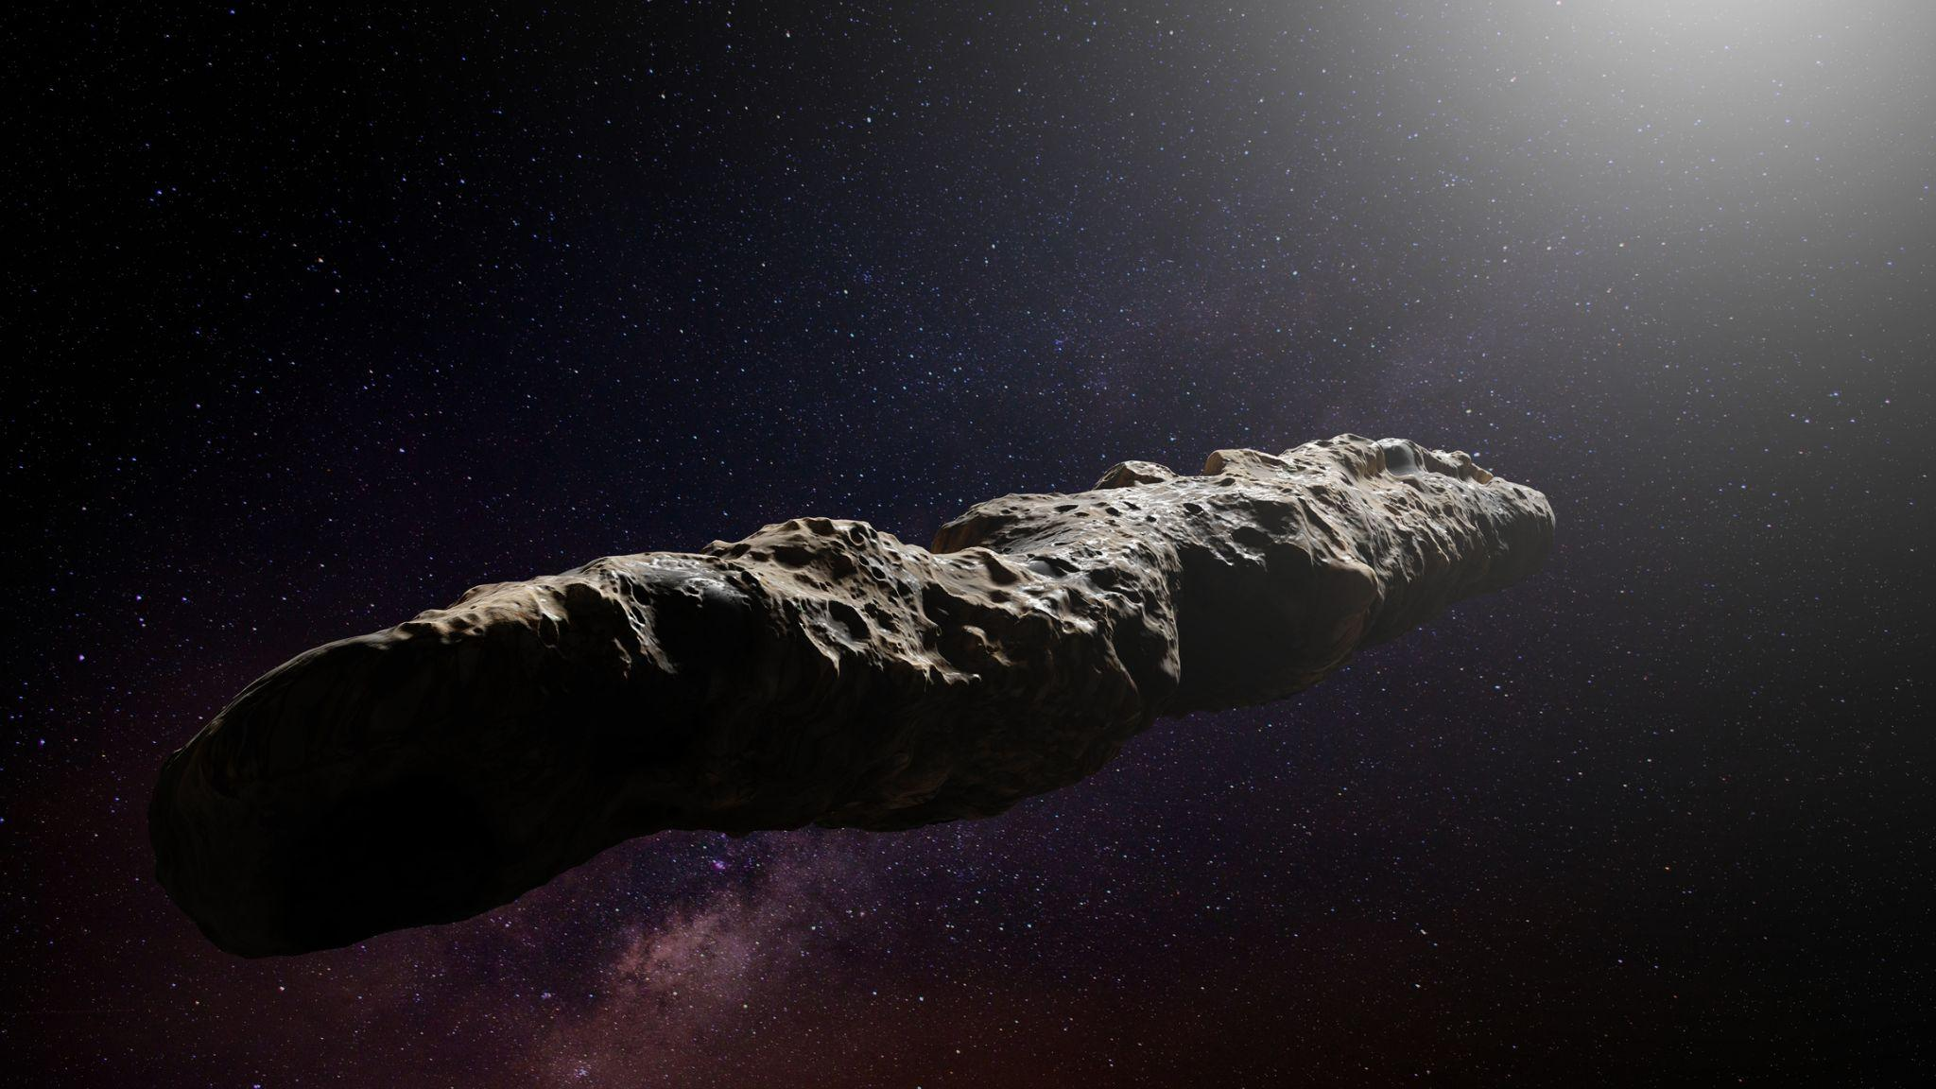
Oumuamua
2017
First known interstellar object
Still debated
Notes:
First known interstellar object detected in our solar system. It accelerated away from the sun without a visible tail like comets usually have.

Slide 5
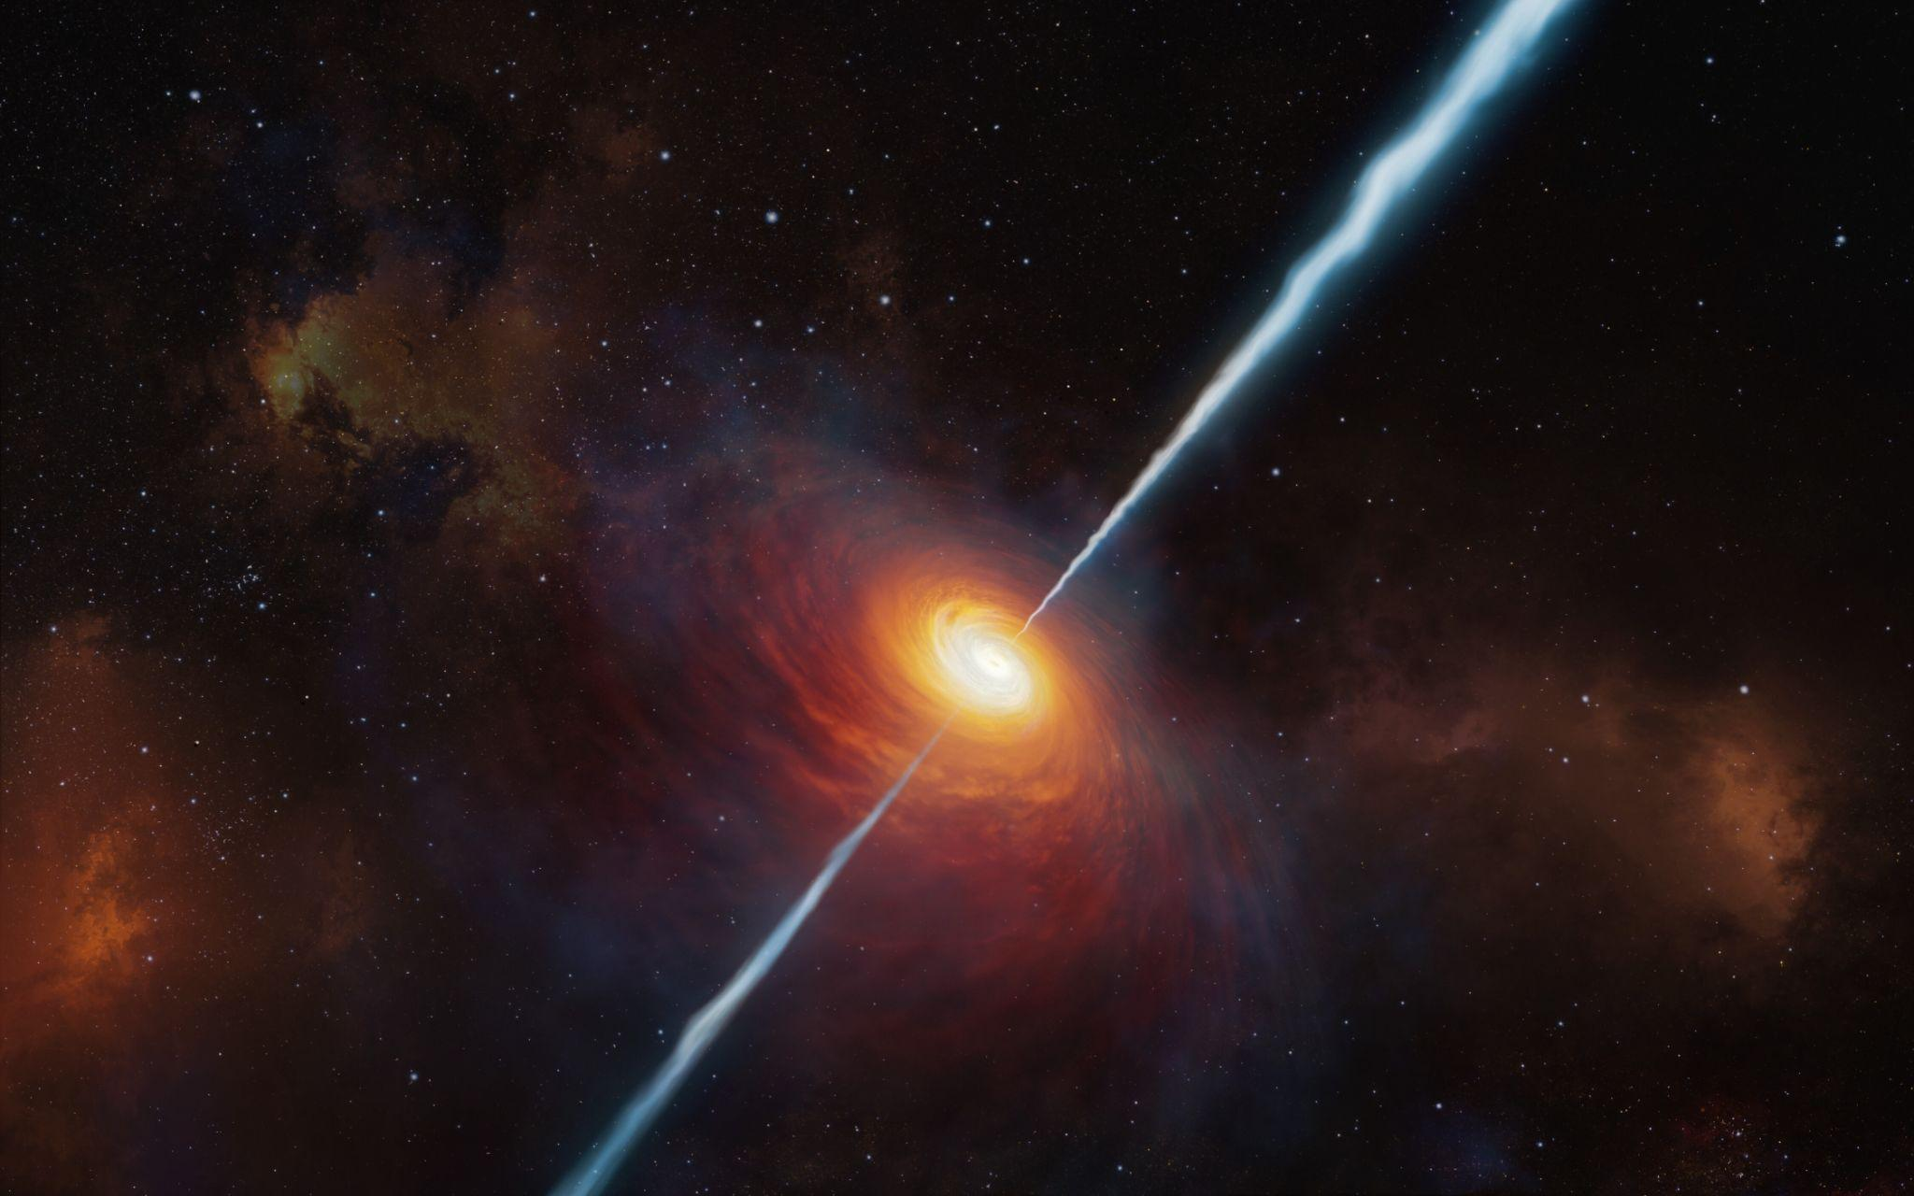
LGM-1 (“Little Green Men”)
1967
Discovered by Jocelyn Burnell
Pulses were exactly 1.3 seconds apart
Album cover for Unknown Pleasures by Joy Division

Slide 6
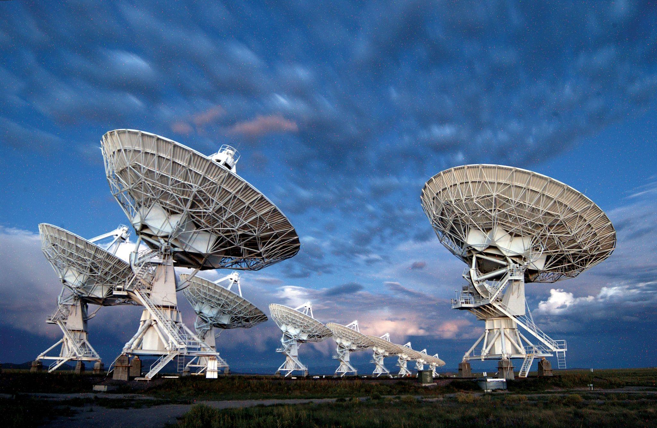
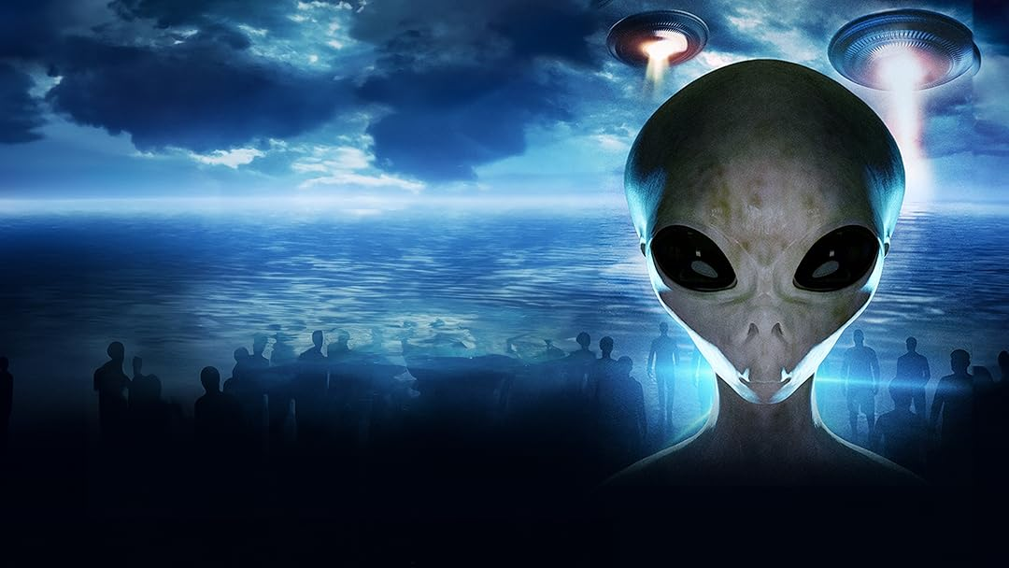
Why Haven’t We Found Anything
Little government interest
Insanely large distances
Super direct transmissions
Wrong signals
The “Great Filter”
Only searching for about 50 years (0.000000003%)
Notes:
NASA is 0.3% and was 0.7% during the space race
Overall, 65% of U.S. adults say it is essential that NASA continue to be involved in space exploration, the survey finds. A smaller share (32%) believe that private companies will ensure enough progress is made in space exploration, even without NASA's involvement.
Life has been possible for just under 13 billion years

Slide 7
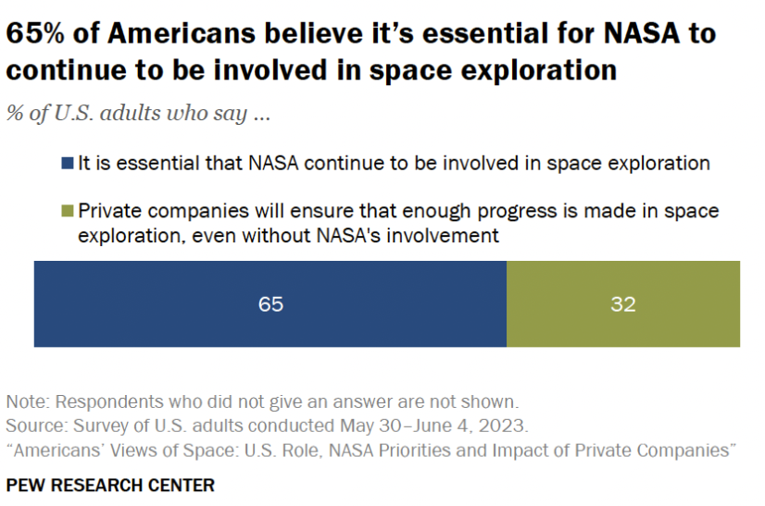
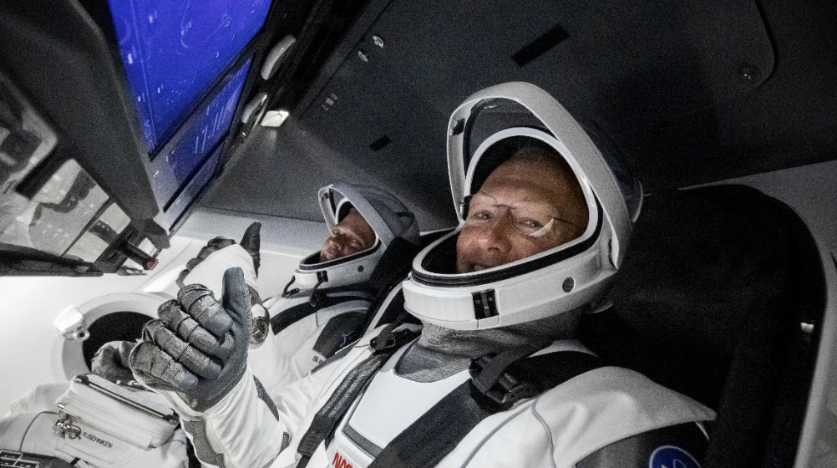
How This Affects Society
International/Interplanetary issue
Alien myths bring us together
Collaboration
Change in ideals
Being alone
Notes:
WILL I close my eyes and listen.
JULIA I feel them all around me, shuffling and breathing and
being.
WILL I open my eyes and look.
ALICE And I think, if we are feeling this together,
if we are in this moment together,
maybe that’s enough.

Slide 8
“The Science behind “Unknown Pleasures.”” Royvanrijn.com, 16 Feb. 2015, www.royvanrijn.com/blog/2015/02/the-science-behind-unknown-pleasures/. Accessed 19 May 2025.
The. “What Distinguishes a Star from a Quasar? - National Radio Astronomy Observatory.” National Radio Astronomy Observatory, 2021, public.nrao.edu/ask/what-distinguishes-a-star-from-a-quasar/.
‌LEMMiNO. “The Great Silence.” YouTube, 30 Nov. 2018, www.youtube.com/watch?v=ryg077wBvsM. Accessed 4 July 2020.
Murphy, Chad. “’3 Body Problem’: Netflix Sci-Fi Show Makes Mysterious Ohio State Wow! Signal a Plot Point.” Yahoo Entertainment, 16 Apr. 2024, www.yahoo.com/entertainment/3-body-problem-netflix-sci-173531923.html. Accessed 19 May 2025.
‌

